Slide 1
MATLAB®
Introduction to
Numeric Differentiation

Slide 2
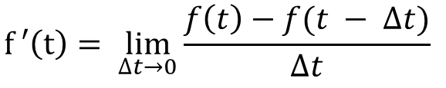
Derivative
The derivative measures the instantaneous rate of change and is defined as:

Slide 3

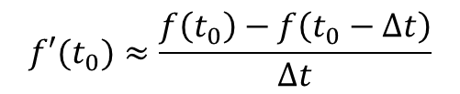
2-Point Estimate for 1st Derivative
Forward estimate
Reverse estimate
Accuracy depends on two things:
choice of ∆t
how rapidly f(t) is changing at t₀

Slide 4

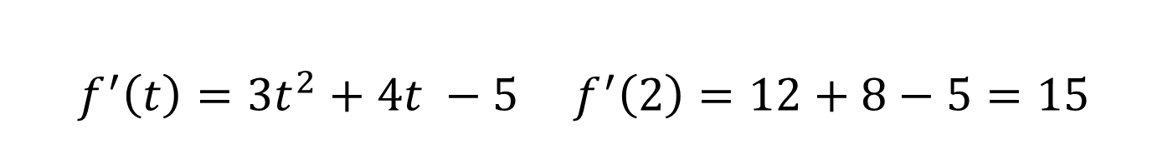
Example 1
Find the derivative of the function shown below at t = 2?
$$f\left(t\right)=t^{3}+2t^{2}−5t+10$$
Should we use the forward or reverse 2 PT estimate?
Neither! It makes no sense whatsoever to use an estimate equation when we have a function that we can simply take the derivative of.
$$f^{′}\left(t\right)=3t^{2}+4t −5 f^{′}\left(2\right)=12+8−5=15$$

Slide 5
Example 2
Using the velocity data in the table, apply the forward and reverse 2 PT estimates to estimate the acceleration of the object at t = 2 seconds.
Time (s) | Velocity (cm/s)
0.0 | 1.0
0.5 | 1.6
1.0 | 2.7
1.5 | 4.5
2.0 | 7.4
2.5 | 12.2
3.0 | 20

Slide 6
Example 3
Using the position measurements shown in the graph, apply the forward and reverse 2 PT estimates to estimate the velocity of the object at t = 2 seconds.

Slide 7
Example 3 (con’t)
If we were measuring the position of the object in real-time, which of the two estimates (forward or reverse) would be best to apply? Why?

Slide 8
Improving Derivative Estimates
How can we improve the accuracy of our estimate?
Decrease Δt
Unfortunately, we cannot do that once we’ve already collected our data
How looking back at our previous example, how might we improve our estimate using the two estimates we computed?
Take the average of the two values

Slide 9

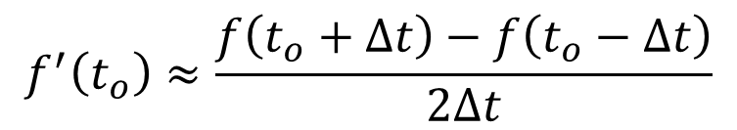
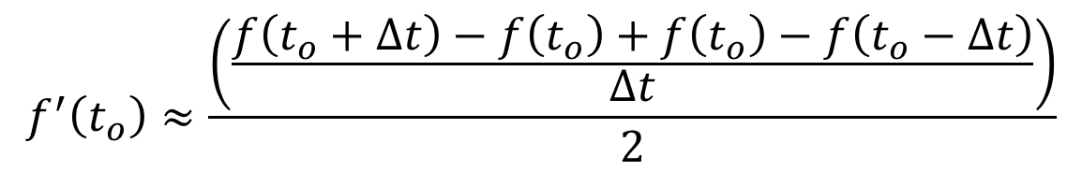
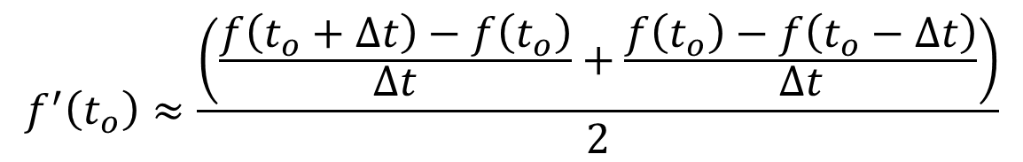
Improving Derivative Estimates
$$f^{′}\left(t_{o}\right)≈\frac{\left(\frac{f\left(t_{o}+∆t\right)−f\left(t_{o}\right)}{∆t}+\frac{f\left(t_{o}\right)−f\left(t_{o}−∆t\right)}{∆t}\right)}{2}$$
$$f^{′}\left(t_{o}\right)≈\frac{\left(\frac{f\left(t_{o}+∆t\right)−f\left(t_{o}\right)+f\left(t_{o}\right)−f\left(t_{o}−∆t\right)}{∆t}\right)}{2}$$
$$f^{′}\left(t_{o}\right)≈\frac{f\left(t_{o}+∆t\right)−f\left(t_{o}−∆t\right)}{2∆t}$$

Slide 10
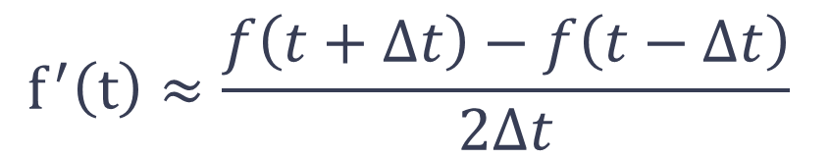
3-Point Estimate for First Derivative
$$f^{′}\left(t\right)≈\frac{f\left(t+∆t\right)−f\left(t−Δt\right)}{2∆t}$$
The 3-point estimate is more accurate than the 2-point estimate for a given Δt.

Slide 11
Example 4
Using the velocity data in the table, apply the 3 PT estimate to estimate the acceleration of the object at t = 2 seconds.
Time (s) | Velocity (cm/s)
0.0 | 1.0
0.5 | 1.6
1.0 | 2.7
1.5 | 4.5
2.0 | 7.4
2.5 | 12.2
3.0 | 20

Slide 12
Example 5
Using the position measurements shown in the graph, apply the 3 PT estimate to estimate the velocity of the object at
t = 2 seconds.

Slide 13
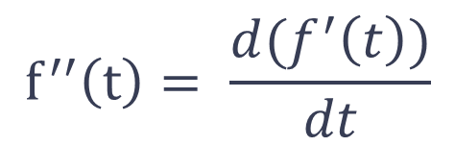
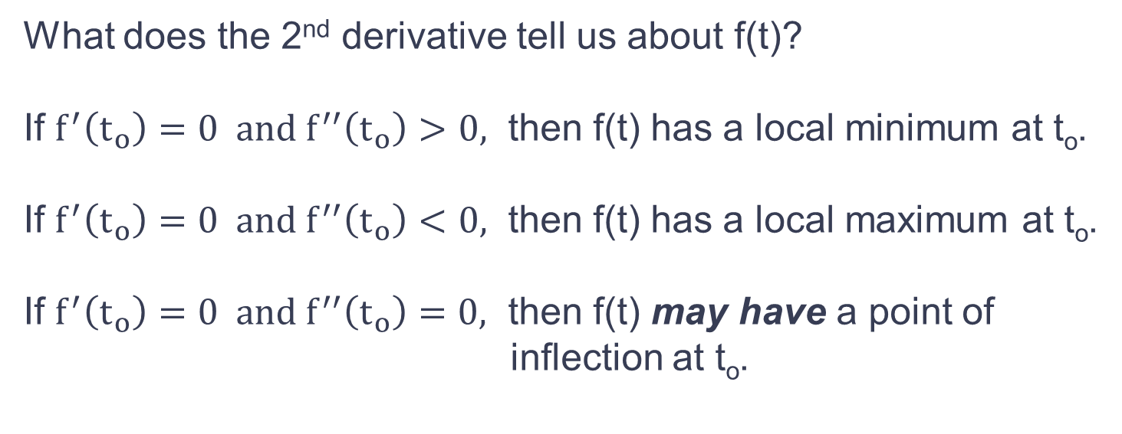
Second Derivative
$$f^{′′}\left(t\right)= \frac{d(f^{′}\left(t\right))}{dt}$$
What does the 2nd derivative tell us about f(t)?
If $f^{′}\left(t_{o}\right)=0 and f^{′′}\left(t_{o}\right)>0,$ then f(t) has a local minimum at t_{o}.
If $f^{′}\left(t_{o}\right)=0 and f^{′′}\left(t_{o}\right)<0,$ then f(t) has a local maximum at t_{o}.
If $f^{′}\left(t_{o}\right)=0 and f^{′′}\left(t_{o}\right)=0,$ then f(t) may have a point of
inflection at t_{o}.

Slide 14
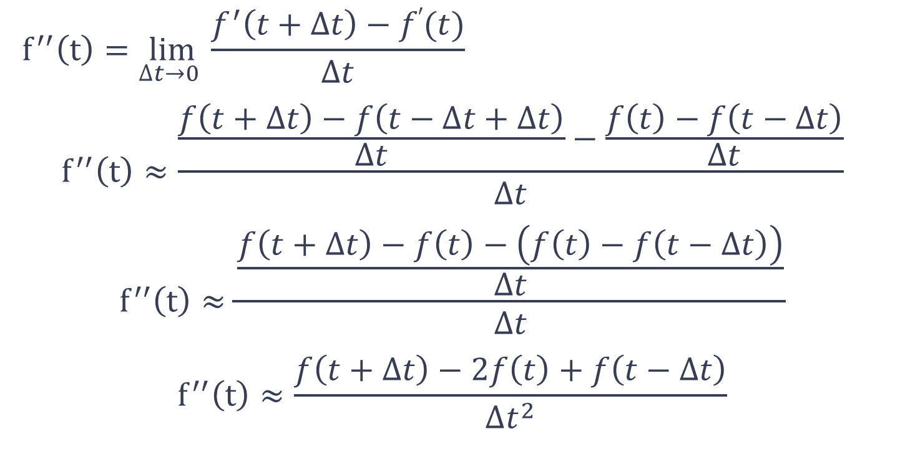
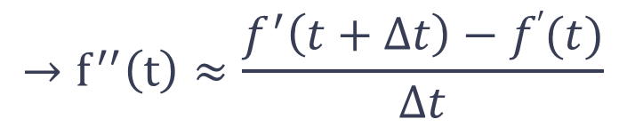
Numerical Approximation of 2nd Derivative
$$f^{′′}\left(t\right)=\lim_{∆t→0 }{\frac{f^{′}\left(t+∆t\right)−f′(t)}{∆t}}→f^{′′}\left(t\right)≈\frac{f^{′}\left(t+∆t\right)−f′(t)}{∆t}$$
$$f^{′′}\left(t\right)≈\frac{\frac{f\left(t+∆t\right)−f\left(t−∆t+∆t\right)}{∆t}−\frac{f\left(t\right)−f\left(t−∆t\right)}{∆t}}{∆t}$$
$$f^{′′}\left(t\right)≈\frac{\frac{f\left(t+∆t\right)−f\left(t\right)−\left(f\left(t\right)−f\left(t−∆t\right)\right)}{∆t}}{∆t}$$
$$f^{′′}\left(t\right)≈\frac{f\left(t+∆t\right)−2f\left(t\right)+f\left(t−∆t\right)}{∆t^{2}}$$
$$→f^{′′}\left(t\right)≈\frac{f^{′}\left(t+∆t\right)−f′(t)}{∆t}$$

Slide 15

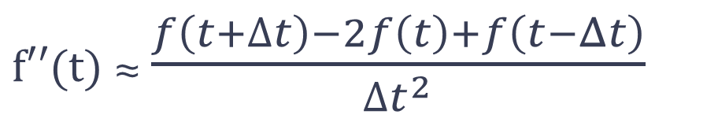
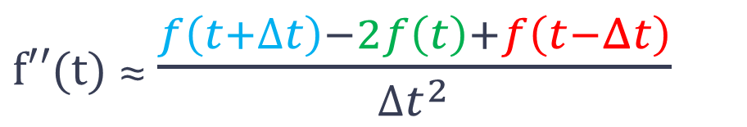
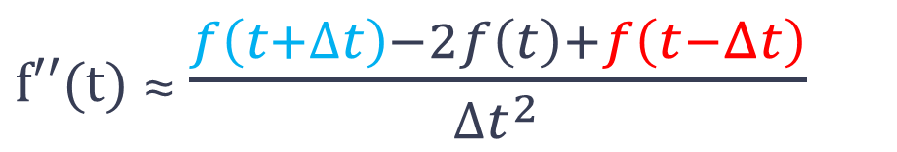
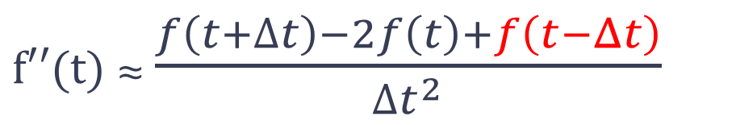
Numerical Approximation of 2nd Derivative
$f′′(t)$ ≈ $\frac{f\left(t+∆t\right)−2f\left(t\right)+f\left(t−Δt\right)}{{∆t}^{2}}$
$f′′(t)$ ≈ $\frac{f\left(t+∆t\right)−2f\left(t\right)+f\left(t−Δt\right)}{{∆t}^{2}}$
$f′′(t)$ ≈ $\frac{f\left(t+∆t\right)−2f\left(t\right)+f\left(t−Δt\right)}{{∆t}^{2}}$
$f′′(t)$ ≈ $\frac{f\left(t+∆t\right)−2f\left(t\right)+f\left(t−Δt\right)}{{∆t}^{2}}$
$f′′(t)$ ≈ $\frac{f\left(t+∆t\right)−2f\left(t\right)+f\left(t−Δt\right)}{{∆t}^{2}}$
for Δt sufficiently small
Requires 3 points, just like the 3 point 1st derivative estimate:
1 point before
1 point behind
Current point

Slide 16
Example 6
Using the position measurements shown in the graph, apply the numerical estimate for the 2nd derivative to estimate the acceleration of the object at t = 2 seconds.

Slide 17
Real-Time Differentiation

Slide 18
Estimating the Derivative from Real-Time Data
If you are taking data in real-time and need a derivative, how would you do this? For example, suppose we have a position sensor which provides a measurement of an object’s position every 0.5 seconds and want to estimate velocity of the object.
How would you determine whether your estimate is accurate since you don’t have an actual derivative to compare it to?

Slide 19
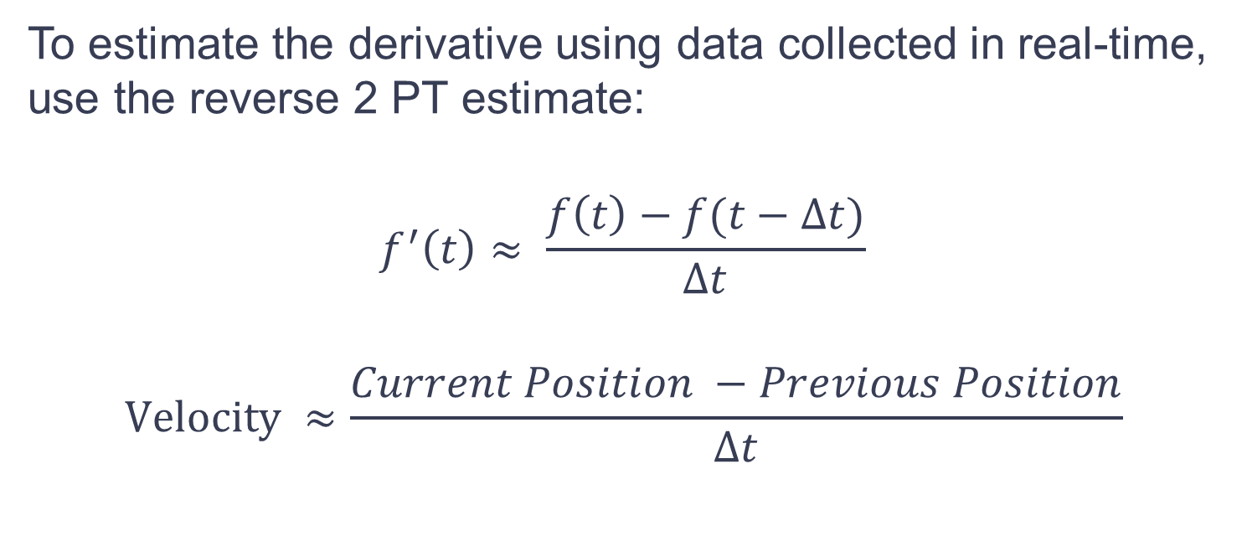
Estimating the Derivative from Real-Time Data
To estimate the derivative using data collected in real-time, use the reverse 2 PT estimate:
$$f^{′}\left(t\right)≈ \frac{f\left(t\right)−f(t−∆t)}{∆t}$$
$$Velocity ≈\frac{Current Position −Previous Position}{∆t}$$

Slide 20
Accuracy and Sample Rate
To get an accurate estimate, you have to sample fast enough. How fast?
It depends on the application. You need to understand your application, what you expect the data to look like, and how quickly changes will occur to decide on a good ∆t. May require some experimentation with different sampling rates.
Downside to sampling too fast: requires faster processor and more data than needed is collected.

Slide 21
GPS Demo
Example: A GPS device produces an estimate of your vehicle velocity based on the position measurements over time.
Run GPS Demo: GPS_Example.m

Slide 22
Angular Velocity Demo
In this GUI, the angular position of the joint in a 2-link robot arm is measured in real-time.
The joint angle follows a smooth polynomial path (same as HW#2)
The angular velocity of the joint is estimated using adjacent position measurements and compared to what the actual velocity would be.
The deltaT can be adjusted to see the effect of sampling time.

Slide 23
Angular Velocity Demo
To run the demo, you need the following files in your current MATLAB folder:
Deriv_Demo.p
Deriv_Demo.fig
Simply type: Deriv_Demo at the MATLAB command prompt.

